Slide 1
Chapter 20
The House Edge:
Expected Value
Lecture Slides

Slide 2
Case Study: The House Edge—Expected Values
If you gamble, you care about two things.
The probability of winning tells you what proportion of a large number of bets will be winners.
You also care about how much you will win because winning a lot is better than winning a little.
You can play games that have enormous jackpots but very small probabilities of winning (multistate lottery) or games with a high probability of winning but smaller jackpots (roulette).

Slide 3
Case Study: The House Edge—Expected Values (continued)
Which is the better gamble: an enormous jackpot with extremely small odds or a modest jackpot with more reasonable odds?
In this chapter, you will learn about expected values.
By the end of this chapter, you will be able to determine whether buying a multistate lottery ticket or simply playing red in roulette is a better bet.

Slide 4
Expected Values 1
Gambling on chance outcomes goes back to ancient times and has continued throughout history.
Both public and private lotteries were common in the early years of the United States.
After disappearing for a century or so, government-run gambling reappeared in 1964, when New Hampshire caused a furor by introducing a lottery to raise public revenue without raising taxes.
Forty-five states now sponsor lotteries.

Slide 5
Expected Values 2
State lotteries made gambling acceptable as entertainment.
Some form of legal gambling is allowed in 48 of the 50 states.
Over half of all adult Americans have gambled legally.
They spend more on betting than on spectator sports, video games, theme parks, and movie tickets combined.

Slide 6
Expected Values 3
If you are going to bet, you should understand what makes a bet good or bad.
As our introductory case study says, we care about how much we win as well as about our probability of winning.

Slide 7
Example: The Tri-State Daily Numbers 1
Here is a simple lottery wager: the “Straight” from the Pick 3 game of the Tri-State Daily Numbers offered by New Hampshire, Maine, and Vermont.
You pay $0.50 and choose a three-digit number. The state chooses a three-digit winning number at random and pays you $250 if your number is chosen.
Because there are 1000 three-digit numbers, you have probability 1/1000 of winning.

Slide 8
Example: The Tri-State Daily Numbers 2
Here is the probability model for your winnings:
Outcome | $0 | $250
Probability | 0.999 | 0.001
What are your average winnings?
The ordinary average of the two possible outcomes $0 and $250 is $125, but that makes no sense as average winnings because $250 is much less likely than $0.

Slide 9
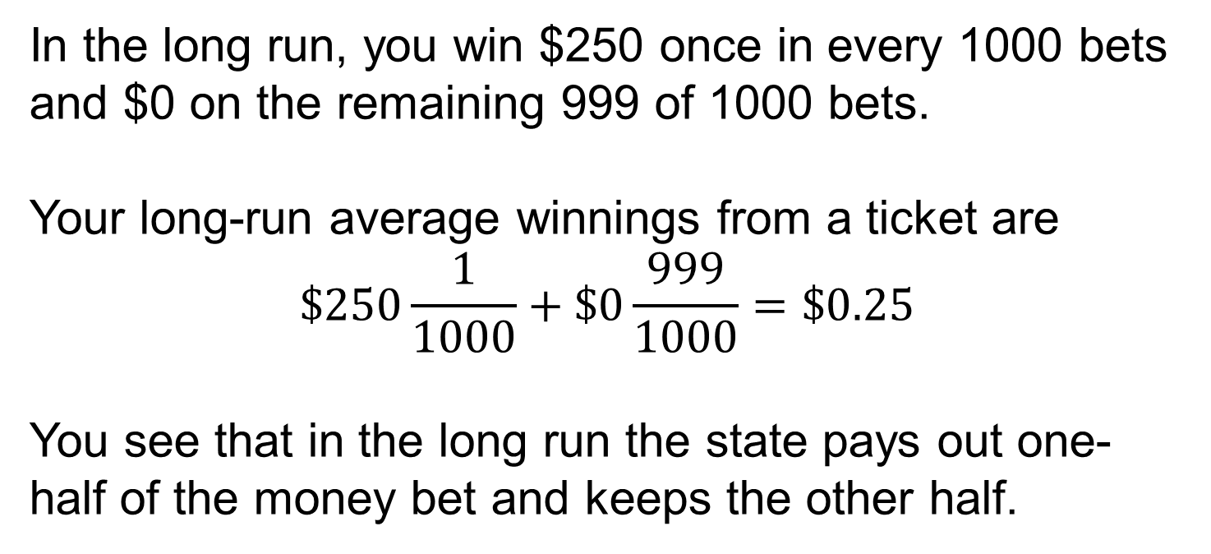
Example: The Tri-State Daily Numbers 3
In the long run, you win $250 once in every 1000 bets and $0 on the remaining 999 of 1000 bets.
Your long-run average winnings from a ticket are
$$\$250\frac{1}{1000}+\$0\frac{999}{1000}=\$0.25$$
You see that in the long run the state pays out one-half of the money bet and keeps the other half.

Slide 10
Expected Values 4
The expected value of a random phenomenon that has numerical outcomes is found by multiplying each outcome by its probability and then adding all the products.
In symbols, if the possible outcomes are
a₁, a₂, . . . , a_{k}
and their probabilities are
p₁, p₂, . . . , p_{k},
then, expected value = a₁p₁ + a₂p₂ + . . . + a_{k}p_{k}

Slide 11
Example: The Tri-State Daily Numbers, continued 1
The Straight wager in Example 1 pays off if you match the three-digit winning number exactly.
You can choose instead to make a $1 StraightBox (six-way) wager. You again choose a three-digit number, but you now have two ways to win.
You win $292 if you exactly match the winning number, and you win $42 if your number has the same digits as the winning number, in any order.
In the long run, you win $292 once every 1000 bets and $42 five times for every 1000 bets.

Slide 12
Example: The Tri-State Daily Numbers, continued 2
The probability model is:
Outcome | $0 | $42 | $292
Probability | 0.994 | 0.005 | 0.001
expected value =
($0)(0.994) + ($42)(0.005) + ($292)(0.001) = $0.502
The StraightBox is a slightly better bet than the Straight bet, because the state pays out slightly more than half the money bet.

Slide 13
Expected Values 5
The Tri-State Daily Numbers is unusual among state lottery games in that it pays a fixed amount for each type of bet.
Most states pay off on the “pari-mutuel” system.
New Jersey’s Pick 3 game is typical: the state pools the money bet and pays out half of it, equally divided among the winning tickets.
The amount your number 123 wins depends both on how much was bet on Pick 3 that day and on how many other players chose the number 123.

Slide 14
Expected Values 6
Without fixed amounts, we can’t find the expected value of today’s bet on 123, but one thing is constant: the state keeps half the money bet.
The idea of expected value as an average applies to random outcomes other than games of chance.
It is used, for example, to describe the uncertain return from buying stocks or building a new factory.

Slide 15
Example: How Many Vehicles per Household?
What is the average number of motor vehicles in American households? The U.S. Energy Information Administration tells us that the distribution of vehicles per household (based on 2017 data) is as follows:
Expected value = (0)(0.09) + (1)(0.34) + (2)(0.33) + (3)(0.15) + (4)(0.06) + (5)(0.02) + (6)(0.01) = 1.85 vehicles per household
Number of vehicles: | 0 | 1 | 2 | 3 | 4 | 5 | 6
Proportion of households: | 0.09 | 0.34 | 0.33 | 0.15 | 0.06 | 0.02 | 0.01

Slide 16
The Law of Large Numbers 1
Expected value is an average of the possible outcomes in which outcomes with higher probability count more.
The expected value also represents the long-run average we will actually see if we repeat a bet many times or choose many households at random.
Mathematicians can prove, starting from just the basic rules of probability, that the expected value calculated from a probability model really is the “long-run average.” This famous fact is called the law of large numbers.

Slide 17
The Law of Large Numbers 2
According to the law of large numbers, if a random phenomenon with numerical outcomes is repeated many times independently, the mean of the actually observed outcomes approaches the expected value.
The law of large numbers is closely related to the idea of probability. In many independent repetitions, the proportion of each possible outcome will be close to its probability, and the average outcome obtained will be close to the expected value.
These facts express the long-run regularity of chance events.

Slide 18
The Law of Large Numbers 3
The law of large numbers explains why gambling, which is a recreation or an addiction for individuals, is a business for a casino.
The “house” in a gambling operation is not gambling at all. The average winnings of a large number of customers will be quite close to the expected value.
The house has calculated the expected value ahead of time and knows what its take will be in the long run.

Slide 19
The Law of Large Numbers 4
If enough bets are placed in a casino, the law of large numbers guarantees the house a profit.
Life insurance companies operate much like casinos: they bet that the people who buy insurance will not die.
Some do die, of course, but the insurance company knows the probabilities and relies on the law of large numbers to predict the average amount it will have to pay out. Then the company sets its premiums high enough to guarantee a profit.

Slide 20
Thinking about Expected Values 1
How large is a large number?
The law of large numbers says that the actual average outcome of many trials gets closer to the expected value as more trials are made.
It doesn’t say how many trials are needed to guarantee an average outcome close to the expected value. That depends on the variability of the random outcomes.
The more variable the outcomes, the more trials are needed to ensure that the mean outcome is close to the expected value.

Slide 21
Thinking about Expected Values 2
Gambles with extremely variable outcomes, such as state lottos with their very large but very improbable jackpots, require impossibly large numbers of trials to ensure that the average outcome is close to the expected value.
The state doesn’t rely on the law of large numbers. Most lotto payoffs, unlike casino games, use the pari-mutuel system. In a pari-mutuel system, payoffs and payoff odds are determined by the actual amounts bet.

Slide 22
Thinking about Expected Values 3
Though most forms of gambling are less variable than lotto, the practical answer to the applicability of the law of large numbers is that the expected value of the winnings for the house is positive and the house plays often enough to rely on it.
Your problem is that the expected value of your winnings is negative.
As a group, gamblers play as often as the house. Because their expected value is negative, as a group, they lose money over time.

Slide 23
Thinking about Expected Values 4
However, this loss is not spread evenly among the many individual gamblers. Some win big, some lose big, and some break even.
Much of the psychological allure of gambling is its unpredictability for the player.
The business of gambling rests on the fact that the result is not unpredictable for the house.

Slide 24
Thinking about Expected Values 5
Serious gamblers often follow a system of betting in which the amount bet on each play depends on the outcome of previous plays.
You might, for example, double your bet on each spin of the roulette wheel until you win—or, of course, until your fortune is exhausted.
Such a system tries to take advantage of the fact that you have a memory even though the roulette wheel does not.

Slide 25
Thinking about Expected Values 6
Can you beat the odds with a system? No.
Mathematicians have established a stronger version of the law of large numbers that says that if you do not have an infinite fortune to gamble with, your average winnings (the expected value) remain the same as long as successive trials of the game (such as spins of the roulette wheel) are independent.

Slide 26
Statistics in Summary
• The expected value is found as an average of all the possible outcomes, each weighted by its probability.
• When the outcomes are numbers, as in games of chance, we are often interested in the long-run average outcome. The law of large numbers says that the mean outcome in many repetitions eventually gets close to the expected value.
• If you don’t know the outcome probabilities, you can estimate the expected value (along with the probabilities) by simulation.

